Slide 1
Dr. Thorium
or: How I learned to stop worrying and Love Nuclear Power
Spencer Swartz

Slide 2
Rule 1: Resonance causes change.
Rule 2: Incorporating story into presentations has an exponential effect on outcomes.
Rule 3: If the author knows the audience’s resonant frequency, and tunes to that, the audience will move.
Rule 4: Every audience will persist in a state of rest unless compelled to change.
Rule 5: Use the big idea to filter out all frequencies other than the resonant frequency.
Rule 6: Structure is greater than the sum of its parts.
Rule 7: Memorable moments are repeated and retransmitted so they cover longer distances.
Rule 8: Audience interest is directly proportionate to the presenter’s preparation.
Rule 9: Your imagination can create a reality.

Slide 3


Slide 5

I agree CO² is bad…

Slide 6

But Spencer… What about Chernobyl?!

Slide 7
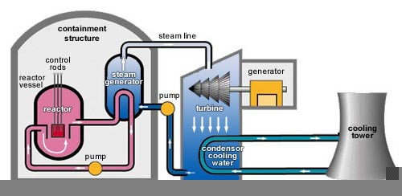
Ooohhh… I’ve heard that’s bad, but I’m not sure how it works.

Slide 8
Incorporate Story bring Up Chernobyl and Jap one Frequently

Slide 9
Compel Change

Slide 10
Future State (Imagined Future Reality)
https://qz.com/89336/everything-you-thought-you-knew-about-the-risks-of-nuclear-energy-is-wrong/

